Slide 1
ImageInsights
Michal Brzus, Ivan Johnson, Zach Morris and Audrey Powers
ECE:5830 Software Engineering Project
Final Presentation
May 3rd, 2024

Slide 2


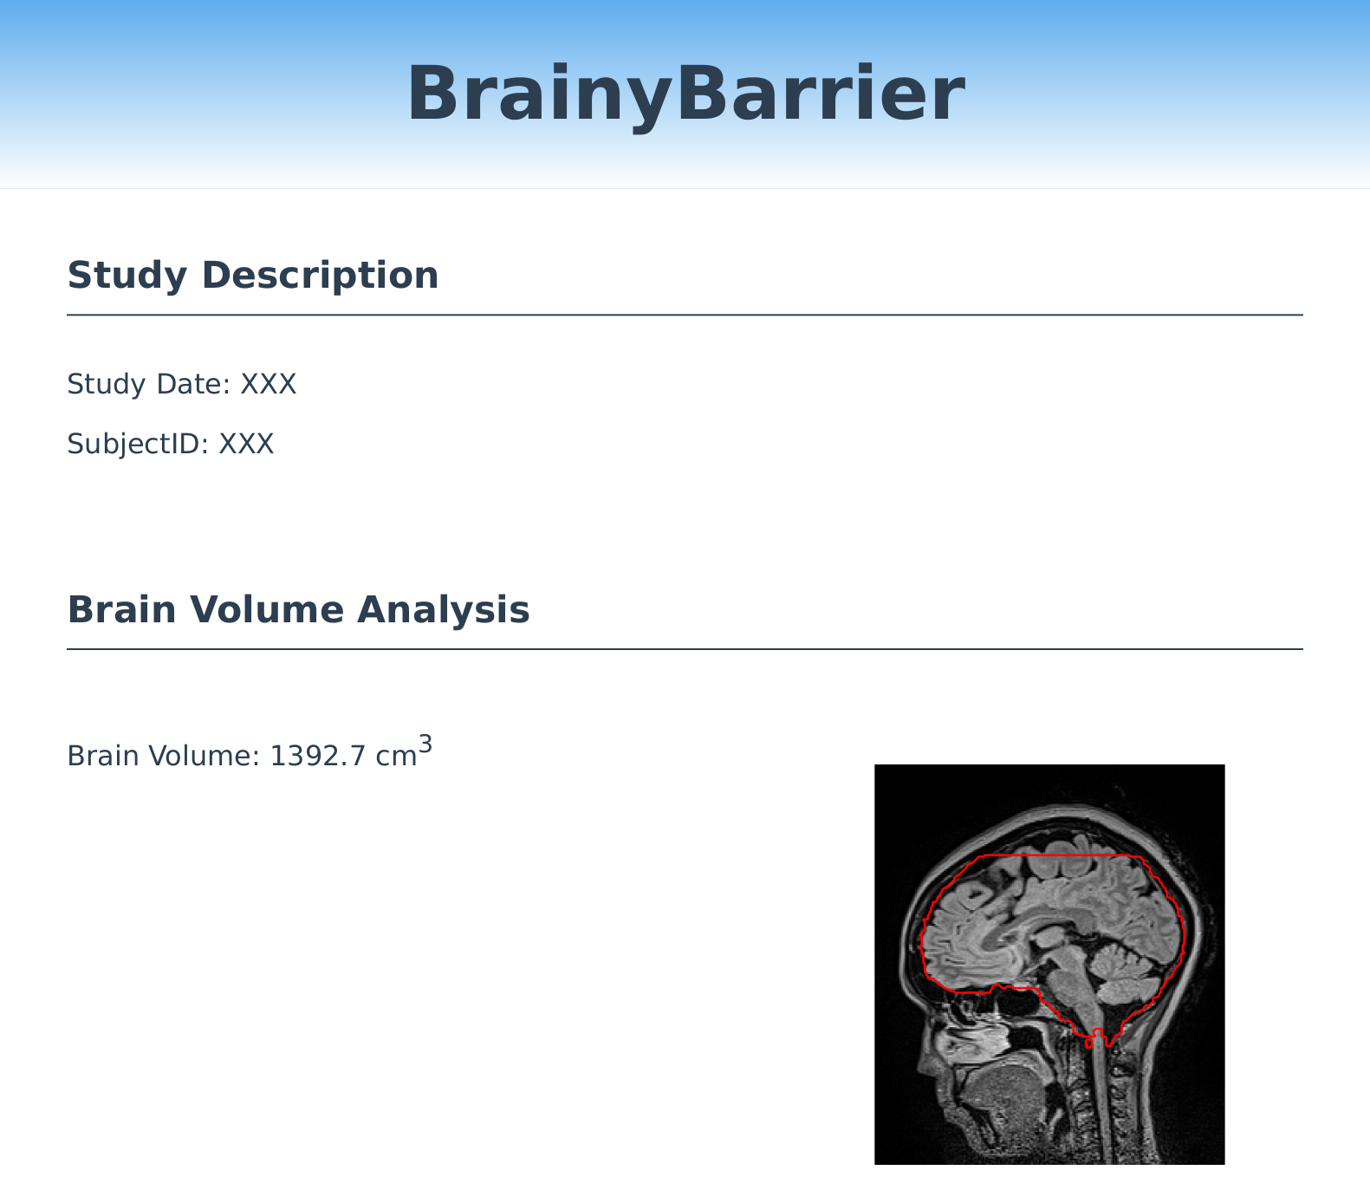
Medical Imaging Products
Product
Imaging Data
Results

Slide 3
Imaging Systems
Hospital
Product

Slide 4
Imaging Systems
Hospital
PACS
PACS
Product

Slide 5

Imaging Systems
Hospital
Study
PACS
PACS
Product
Job Monitoring App
Backend
Frontend
Database

Slide 6
Imaging Systems
Hospital
Study
PACS
PACS
Product
Hospital
Study
PACS
PACS
Product
Hospital
Study
PACS
PACS
Product
Job Monitoring App
Backend
Frontend
Database

Slide 7
Demo

Slide 8
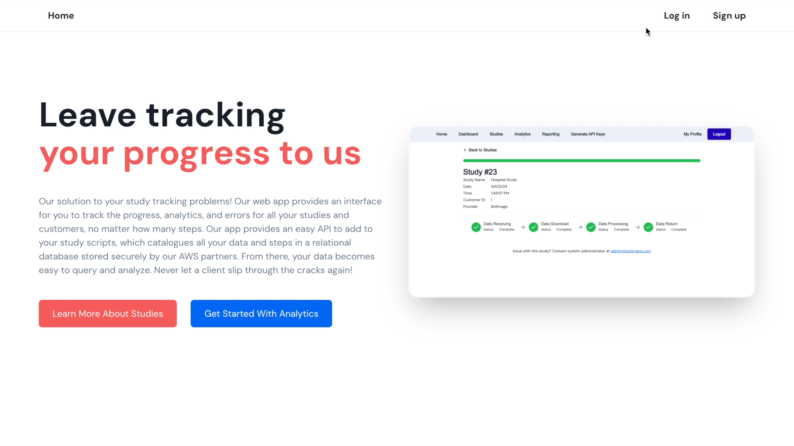

Slide 9
AWS EKS
EKS
Study
Data PVC
Hospital
PACS
PACS
Listening Agent
Study Handler
Product
Frontend
Backend
Database

Slide 10









Tech Platforms and Tools
Accepted
Rejected

Slide 11
Project Evolution
Job Monitoring App Adjustment
Local System Development
Dockerization
Local Kubernetes System
AWS EKS Deployment

Slide 12
Process and Standards
Plan
Design
Implement
Test
Deploy
Templates
Communication
Source Code Management
Documentation

Slide 13
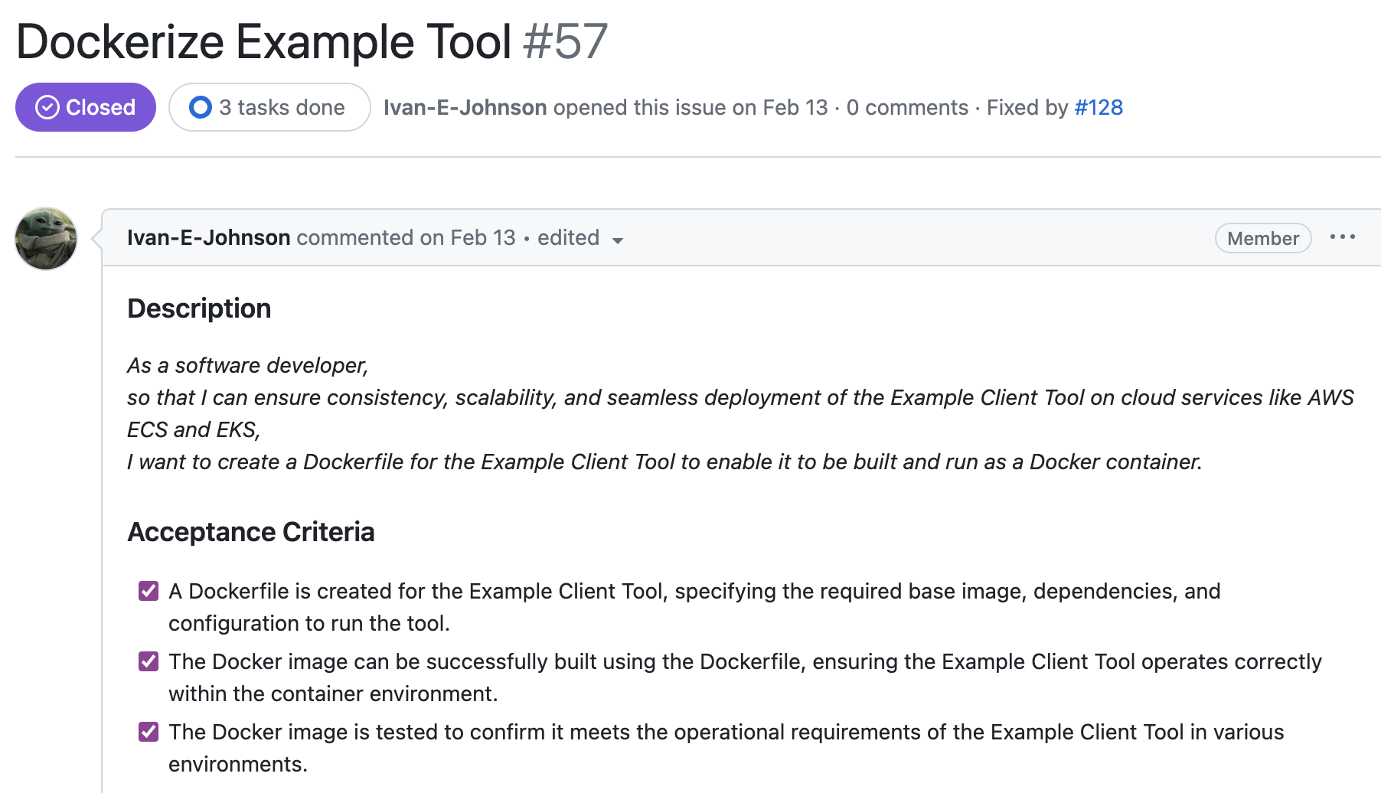
Templates
Bug
Chore
Feature
Documentation
User Story

Slide 14
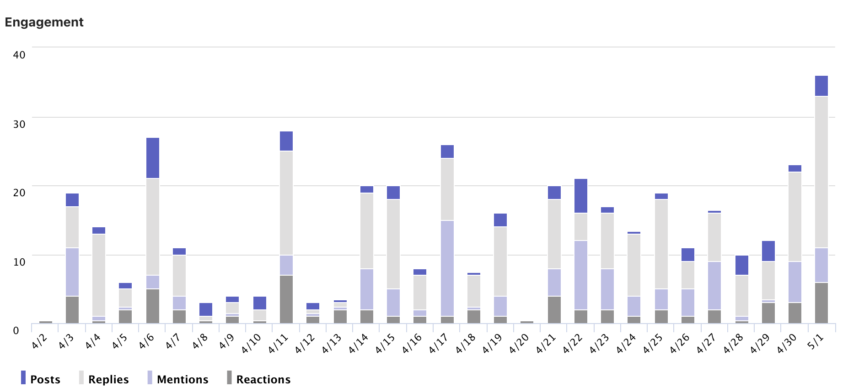
Communication

Slide 15
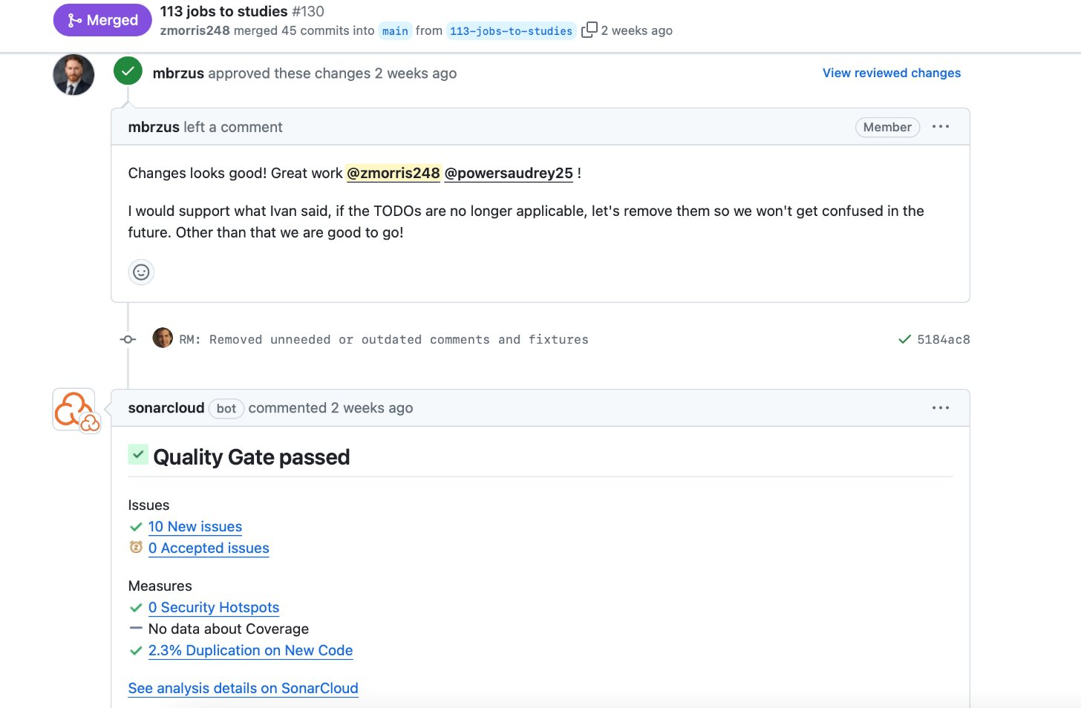
Source Code Management
Github Actions
PRs
Unit Tests
SonarCloud
PreCommit

Slide 16
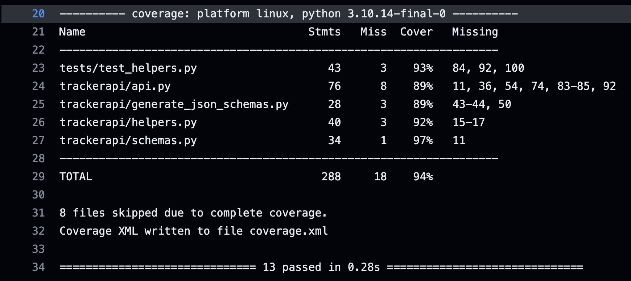
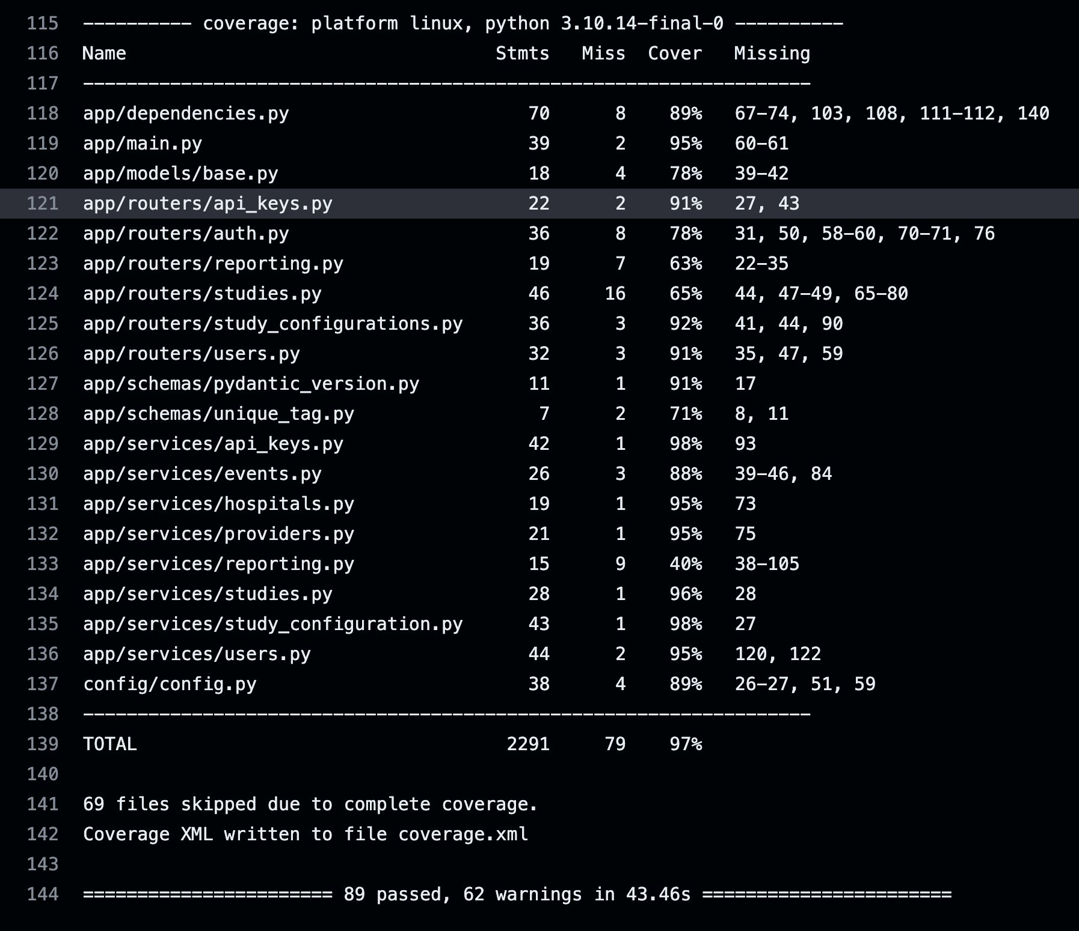
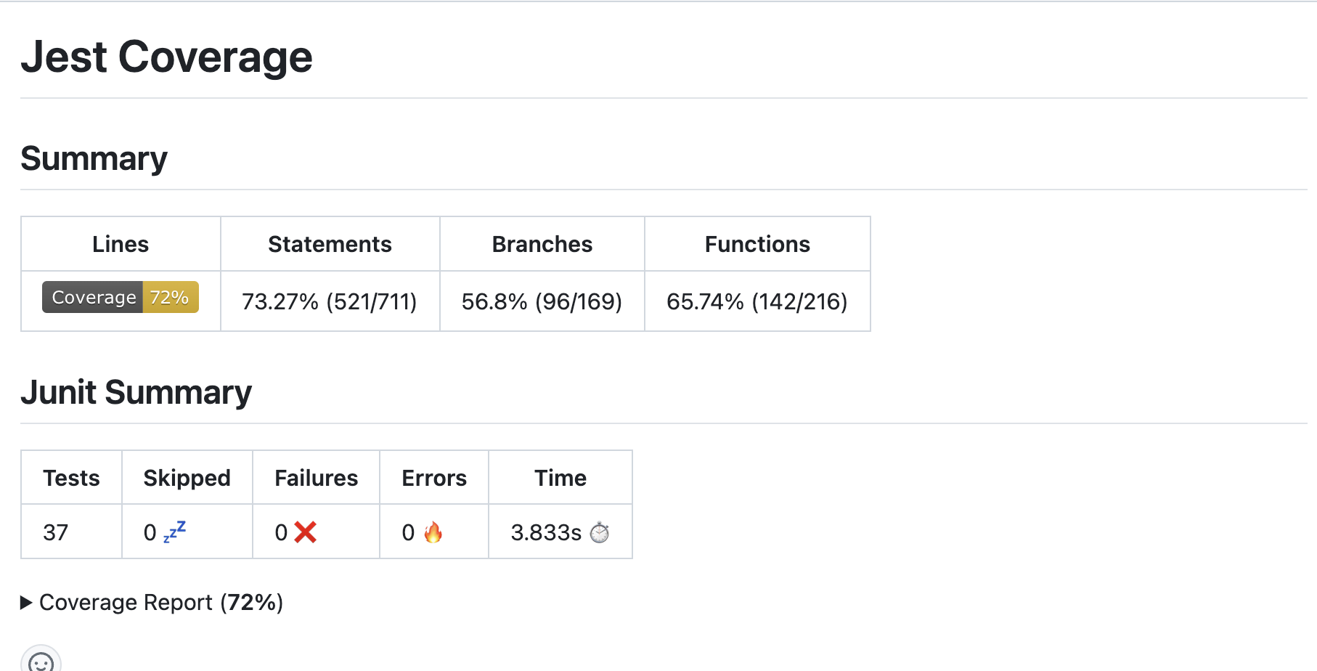
Unit Test Coverage

Slide 17
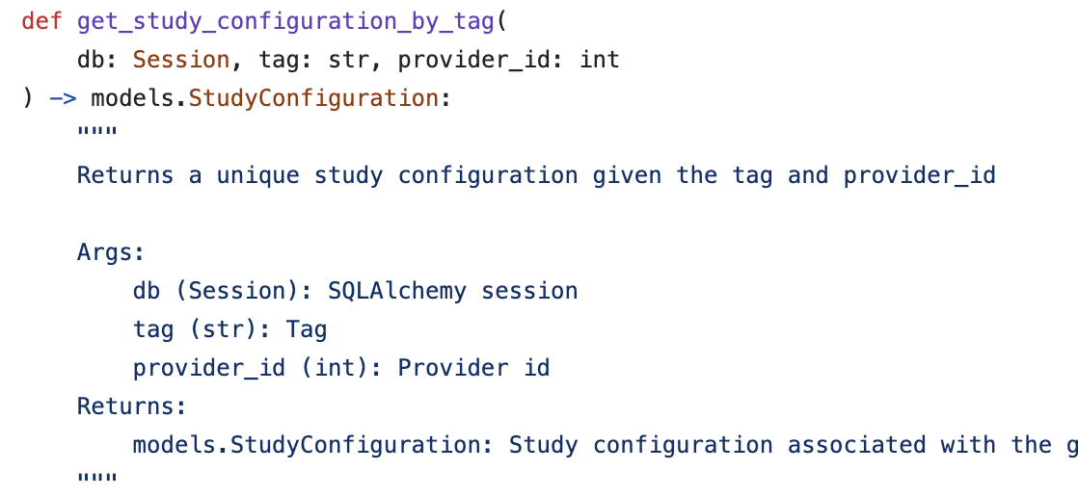
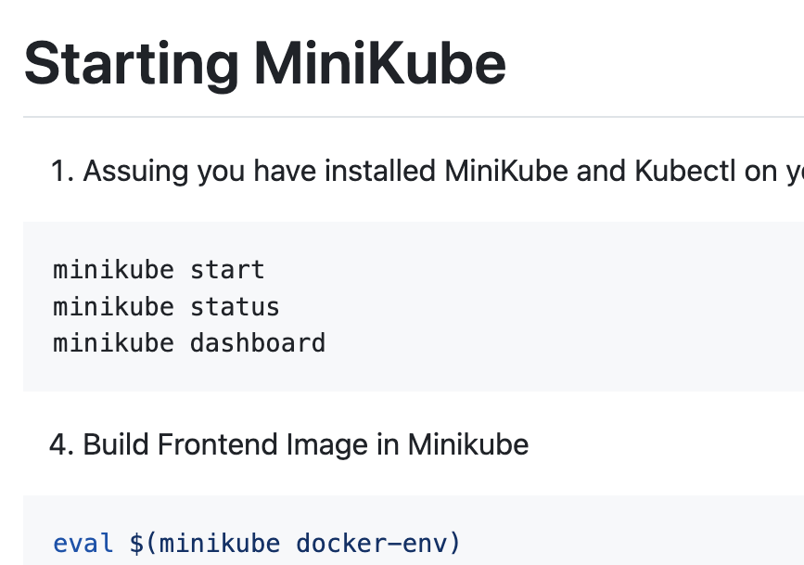
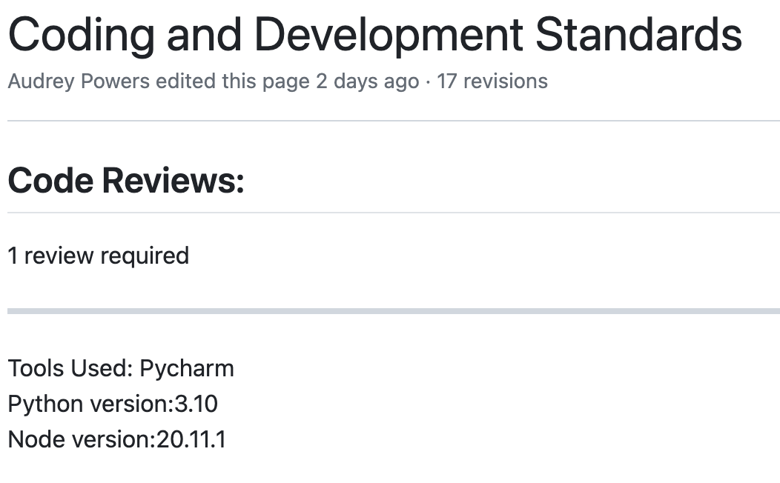
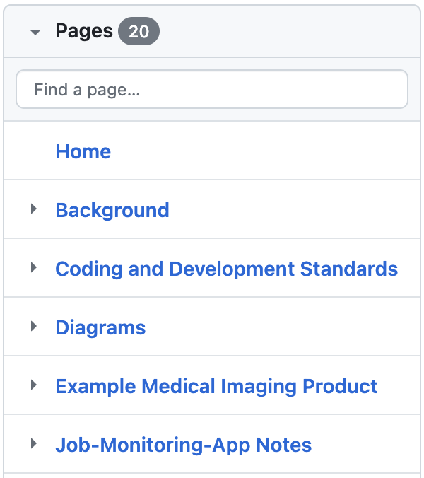
Documentation
Docstrings
READMEs
Wikis

Slide 18
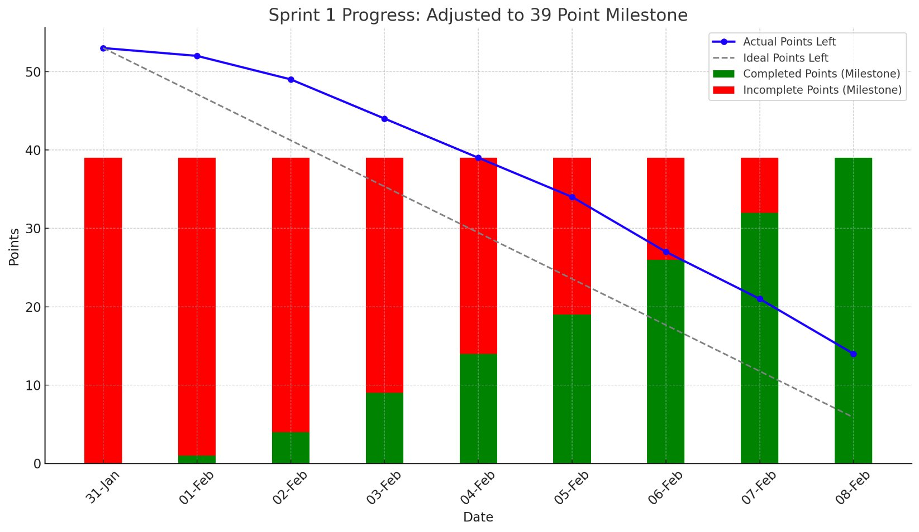
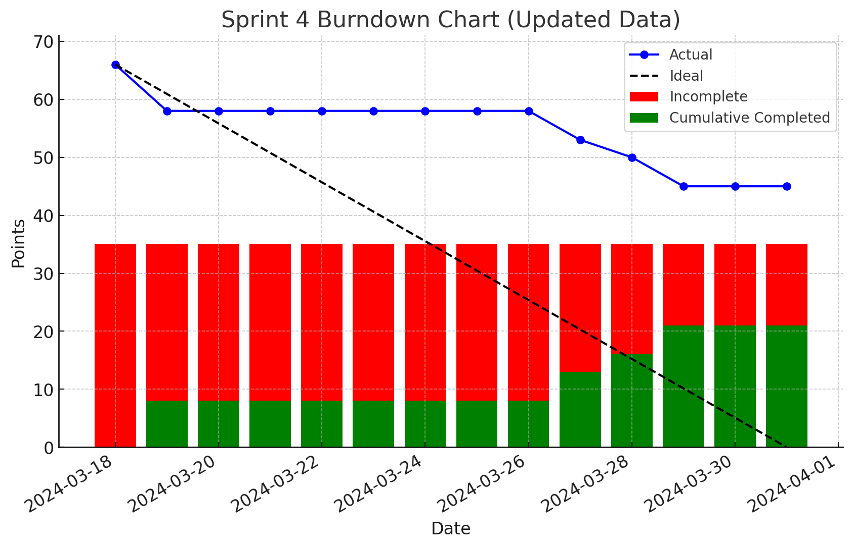
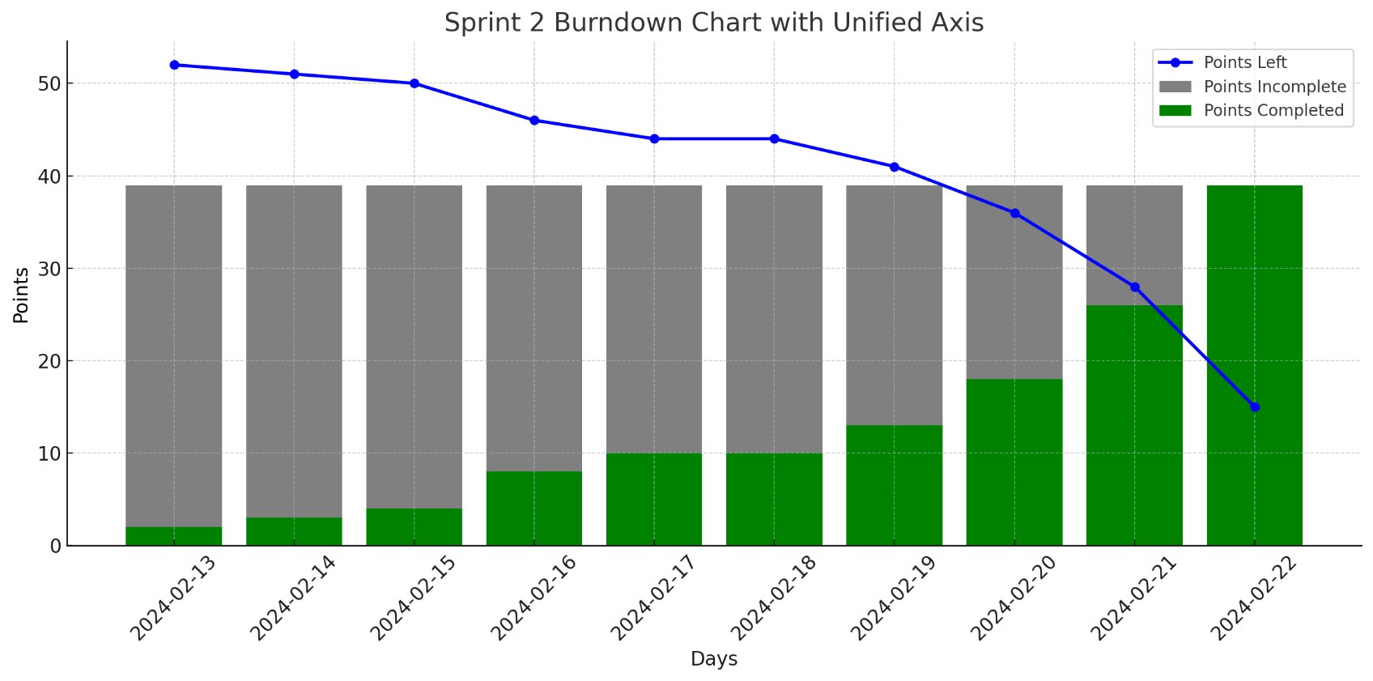
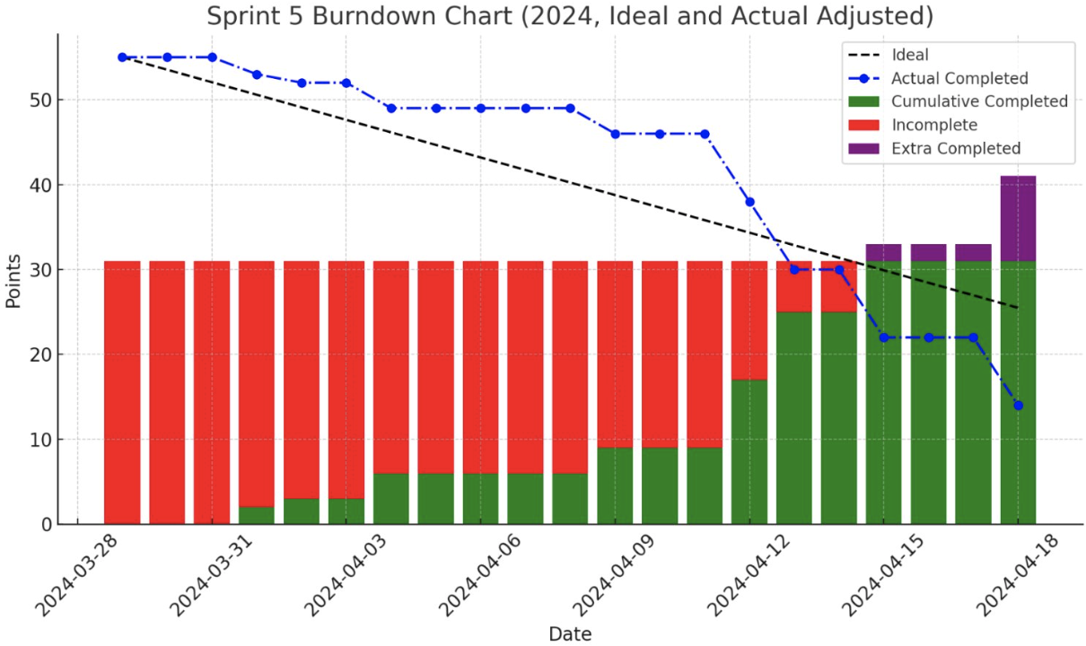
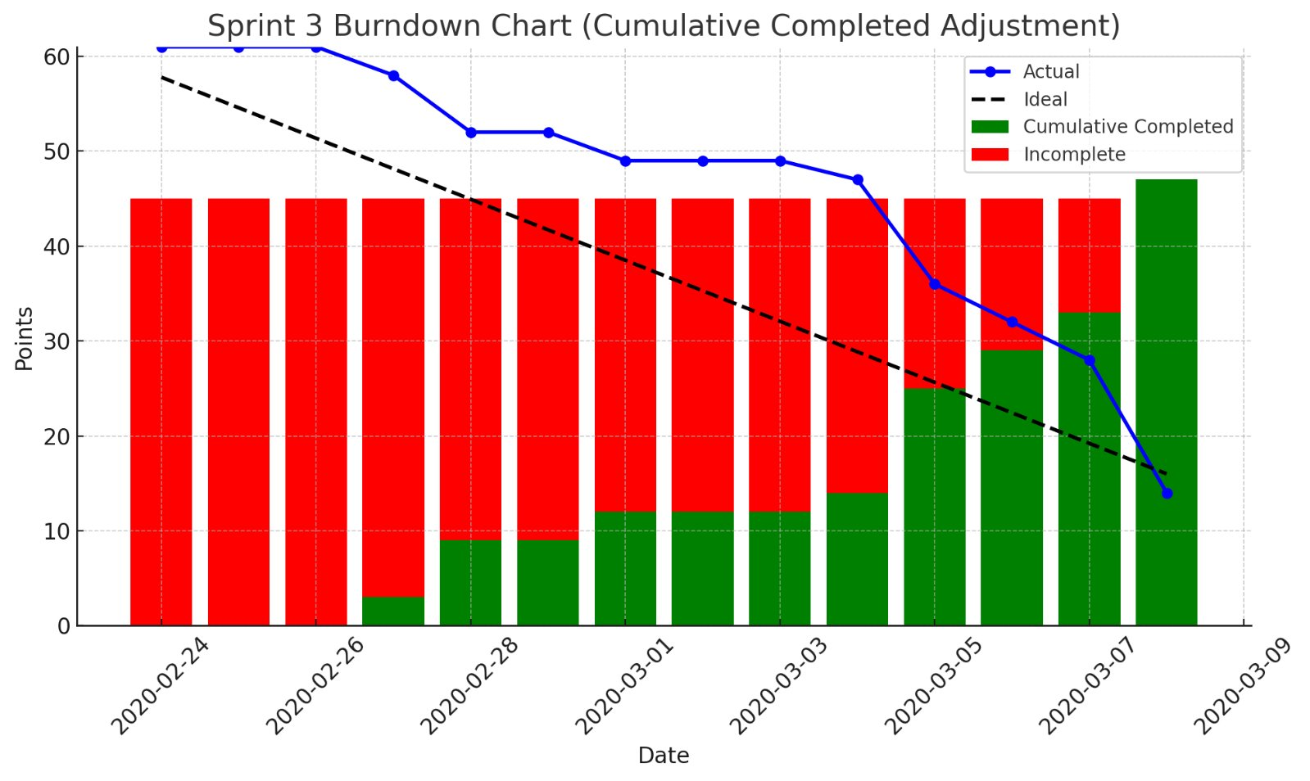
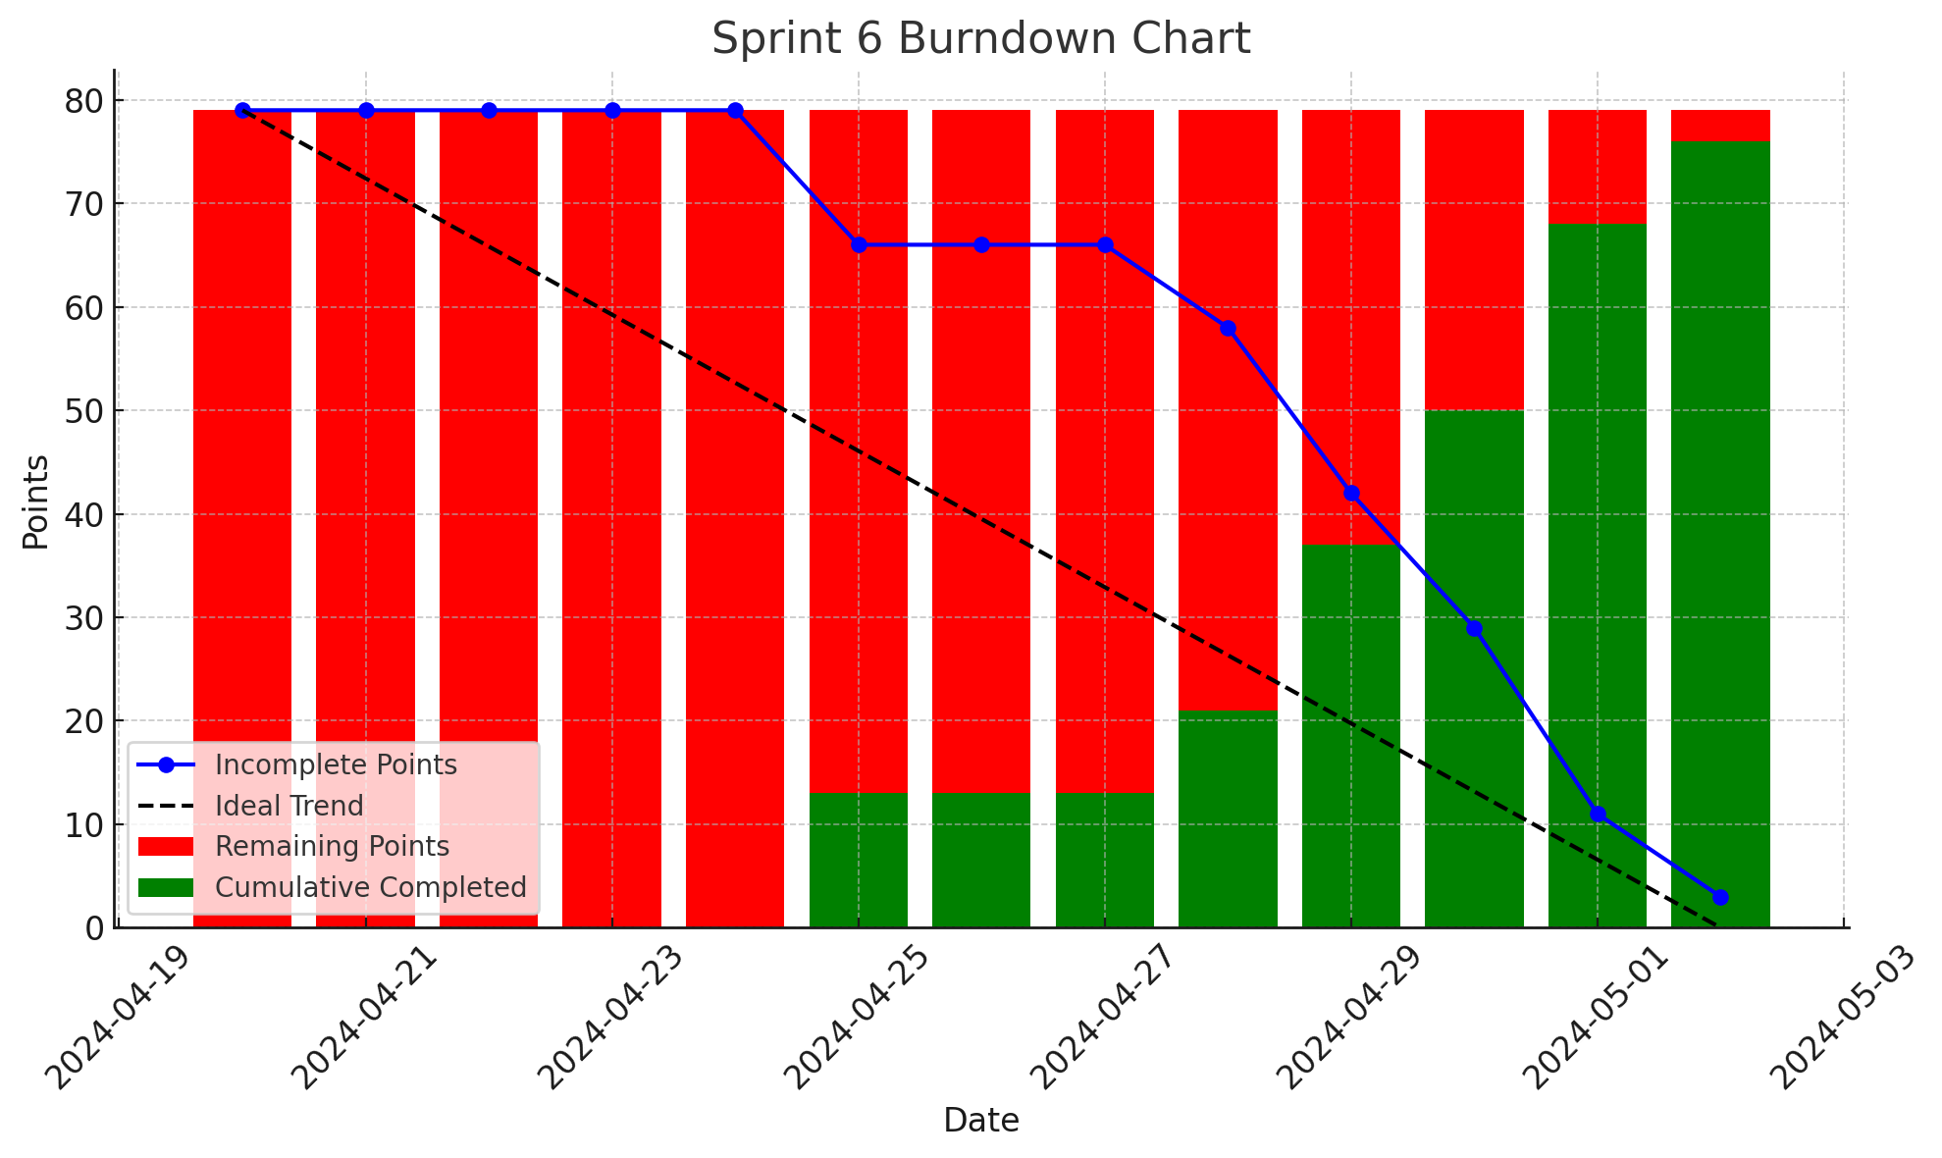
w

Slide 19
Strengths and Weaknesses
Strengths
Weaknesses
Organization
Communication and Collaboration
Prioritization and Planning
Timeboxing Issues
Breaking Down New Issues
Late Deployment

Slide 20
Key Takeaways
Knowledge Sharing
Deploy early and often
Documentation
Planning

Slide 21
Thank you for your time!
Questions

Slide 22
AWS Vocabulary
1. IAM (Identity and Access Management)
Manages access to AWS resources.
2. EC2 (Elastic Compute Cloud)
Virtual servers in the cloud.
3. EKS (Elastic Kubernetes Service)
4. EBS (Elastic Block Store)
9. Load Balancer (ELB)
Automatically adjust the number of EC2 instances in your application.
Ensures you have the correct amount of capacity to handle the load for your application.
Automatically distributes incoming application traffic across multiple targets, such as EC2 instances, containers, and IP addresses.
Used for both throughput and transaction-intensive workloads at any scale.
Managed Kubernetes service.
Supports secure user and permissions setup.
Scalable computing capacity.
Simplifies running Kubernetes on AWS without needing to install and operate your own Kubernetes control plane.
High-performance block storage service.
8. Auto Scaling Groups
Handles the varying load of your application traffic in a single Availability Zone or across multiple Availability Zones.

Slide 23
Kubernetes Vocabulary
1. Cluster
A set of Nodes that run containerized applications. The entire Kubernetes system, managing resources and deployment.
2. Nodes
Physical or virtual machines that are part of the Cluster, each hosting Pods.
3. Pods
4. Services
6. Deployments
5. Ingress
Manages external access to the Services in a cluster, typically HTTP.
Manages a replicated application, ensuring that a specified number of Pod replicas are running at any given time.
An abstraction that defines a logical set of Pods and a policy by which to access them, often used to expose Pods to the internet or other parts of the network.
The smallest deployable units of computing that can be created and managed in Kubernetes, running on Nodes.

Slide 24
AWS EKS
Internet Gateway
VPC
DB Pod
B.E Pod
B.E Pod
Load Balancer
Node 1
B.E Pod
Orthanc
Node 3
F.E. Pod
Listener
Agent
F.E. Pod
Listener
Agent
Node 2
Node 4
Subnet 1
Subnet 2
AWS Cloud

